Slide 1
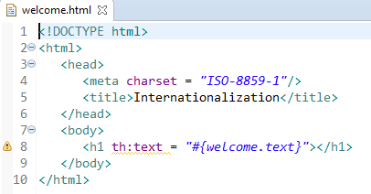


Spring Boot - Internationalization
Internationalization is a process that makes your application adaptable to different languages and regions without engineering changes on the source code. In other words, Internationalization is a readiness of Localization.
The default locale message file name should be messages.properties and files for each locale should name as messages_XX.properties. The “XX” represents the locale code.
In the HTML file, use the syntax #{key} to display the messages from the properties file.

Slide 2
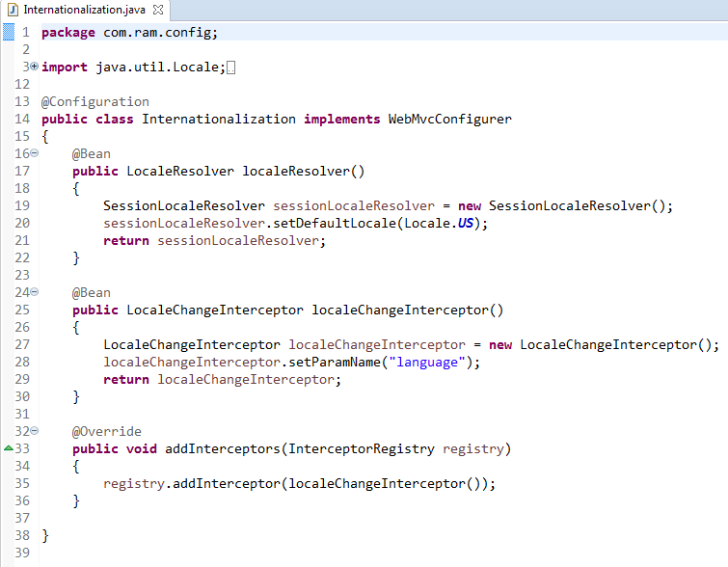
Spring Boot - Internationalization
LocaleChangeInterceptor is a used to change the new Locale based on the value of the language parameter added to a request.
To take this effect, we need to add the LocaleChangeInterceptor into the application’s registry interceptor.
http://localhost:8080/welcome?language=fr
http://localhost:8080/welcome

